Slide 1
Loan Risk
Assessment

Slide 2
Abstract:
The main objective of the project is to analyse and design an AI model which can predict if a person can return his loan with significant accuracy so that bank can lent money as loan.
Credit risk is considered to be one of the biggest risk for banks .Even though the bank takes surety while giving loan such as taking house documents etc but still bank faces loss
For example : If a bank is supposed to sell a house since the person was not able to return the loan sometimes bank will not get the required money through selling the house and ends up in loss.

Slide 3
Introduction:
The project is going to be a web application in which bank authorities can check whether a person will be able to return his loan or not.
The website requires different details such as his age, gender, income, place, previous loan details, job [more or less details might be added according to the requirements].
And will have a button upon clicking will return whether will he return the loan or not with how much Accuracy of prediction.
If required a safe login can be added so that only bank official will have the access.
The model is going to be for a specific bank and specific loan type.

Slide 4
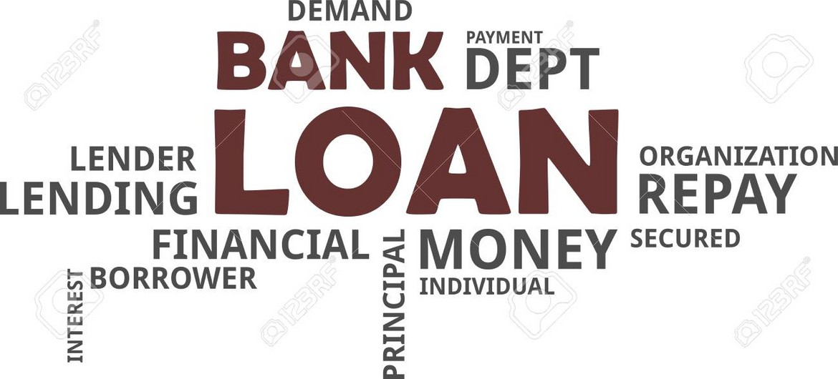
Since Loan could be a lifechanging/lifesaving point of a individual and giving the decision making for a artificially developed intelligence is seen down from
many and if there was even some rare and minor problem it could be affecting one’s life .

Slide 5
Literature Review:
It is said that Credit risk in one of the most actual risk faced by almost every single financial Institution and as we know data has the potential to transform business and drive the creation of business value. Data can be used for a range of simple tasks such as managing dashboards or visualising relationships. However, the real power of data lies in the use of analytical tools that allow the user to extract useful knowledge and quantify the factors that impact events. Some examples include: Customer sentiment analysis, customer churn, geo-spatial analysis of key operation centres, workforce planning, recruiting, or risk sensing.
The objective is to create a credit scoring model for credit data. Various machine learning techniques are used to develop the financial credit scoring model. In this paper, we propose a machine learning classifier based analysis model for credit data. We use the combination of Min-Max normalization and KNearest Neighbor (K-NN) classifier.
The aim of the study is to determine the level of risk represented by different groups (classes) of retail clients (borrowers) in order to reduce and prevent credit risk in the future as well as to improve the management of banking risks. The main results of the study are the creation of a model of borrowers’ internal credit ratings and the development of the methods of improving credit risk management in commercial banks.

Slide 6
Resources:
https://www2.deloitte.com/content/dam/Deloitte/global/Documents/Financial-
Services/gx-be-aers-fsi-credit-scoring.pdf http://www.ijtef.org/papers/203-CF02016.pdf
http://www.ecocyb.ase.ro/nr2019_2/9.%20Coser%20Al.%20Crisan%20Albu%20(T).pdf https://ieeexplore.ieee.org/abstract/document/8389442 https://www.researchgate.net/publication/304669880_Credit_risk_management_in_com mercial_banks https://www.sciencedirect.com/science/article/abs/pii/S0378426602003916?via%3Dihub

Slide 7
WE HAVE
TRIED WITH SEVERAL
MODELS AND
Some of them are: Multilinear regression Polynomial Regression SVR
Tried XGBOOST Decision Tree Random Forest
GOING TO
IMPLEMENT
THE BEST ONE

Slide 8
So the Data set is taken from a kaggle competetion
The following Dataset has 30,000 different data

Slide 9
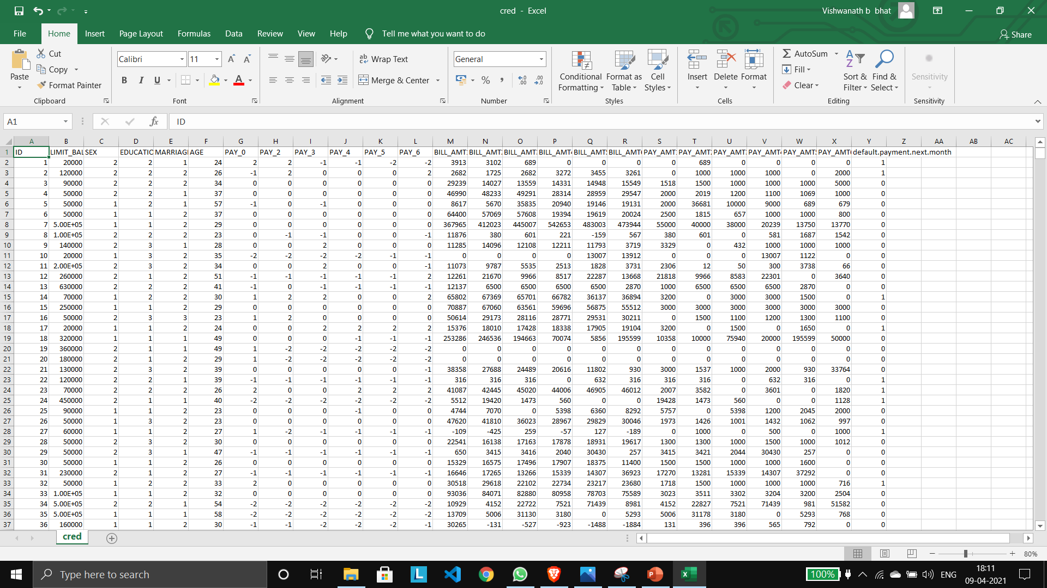

Slide 10
Before Moving On to the coding Part Let us see the logics behind the process

Slide 11
WE FOLLOW MANY
STEPS IN BUILDING A EFFICIENT MODEL
Some of them are:
Data preprocessing
:Feature Scaling
:Remove Unwanted data
:Apply the algo efficiently

Slide 12
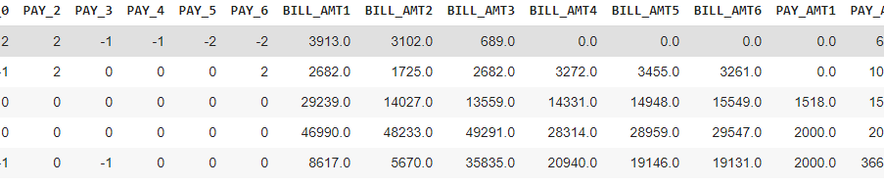
Feature Scaling

Slide 13
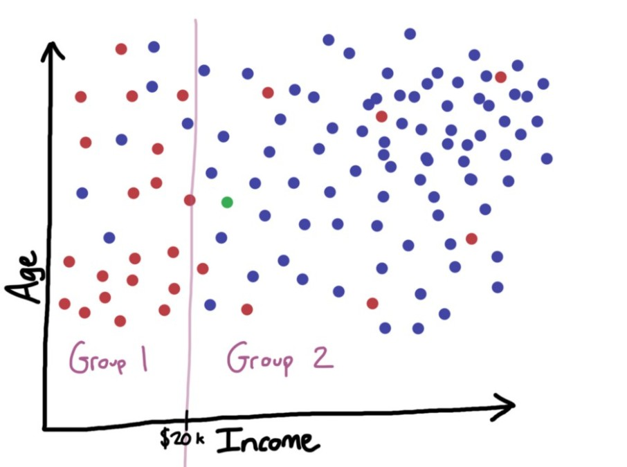
Decision Tree
For simple Explanation let us consider following example

Slide 14
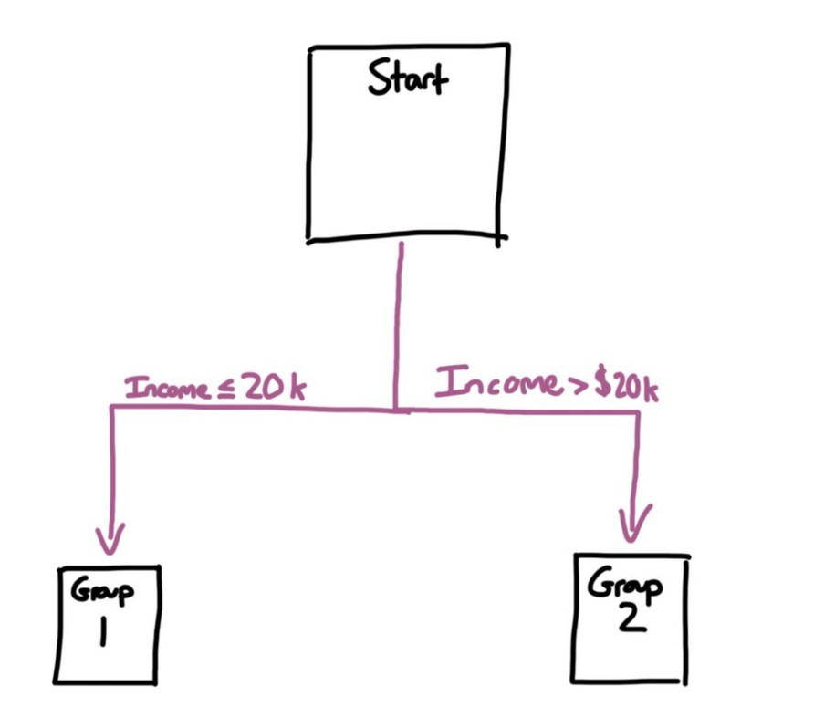
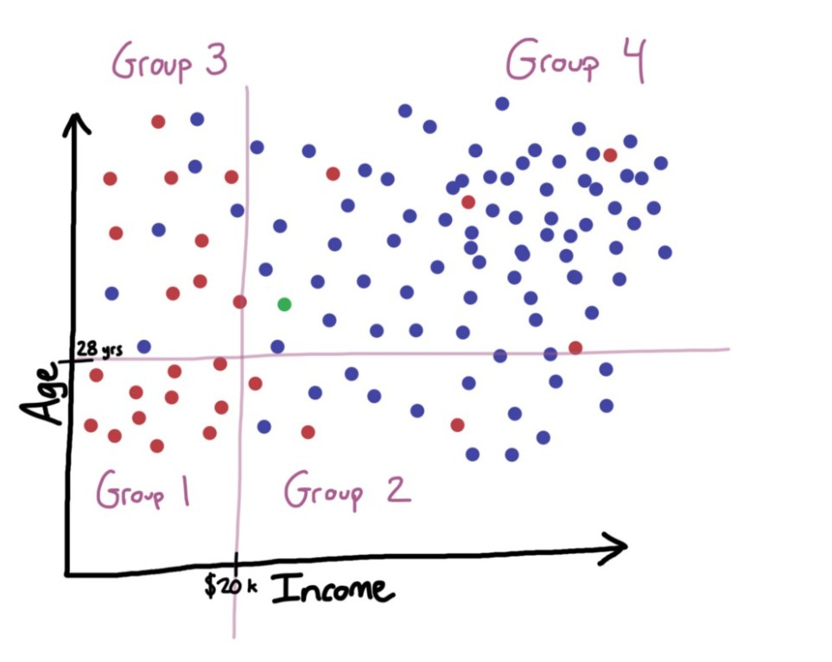

Slide 15
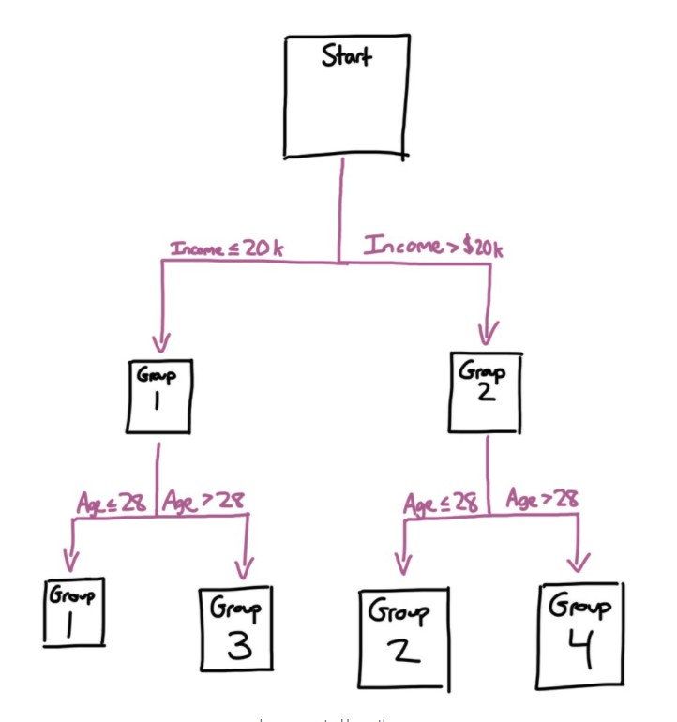

Slide 16

Random Forest
Average

Slide 17
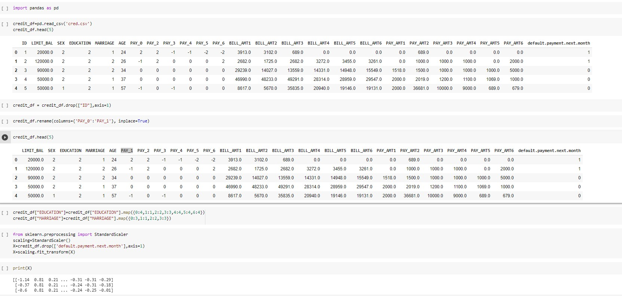

Slide 18
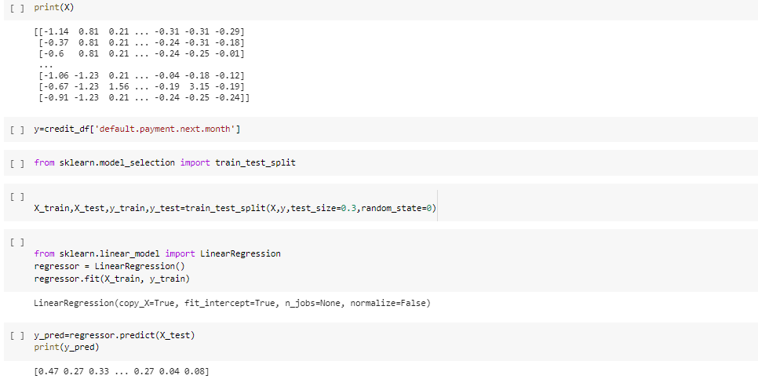
Multilinear

Slide 19
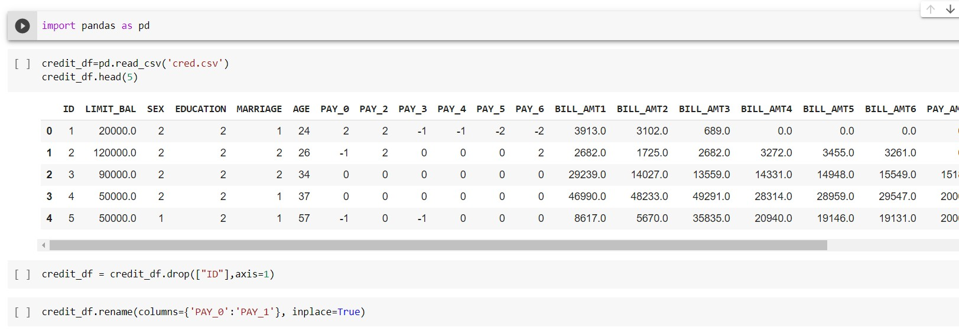
Random Forest

Slide 20
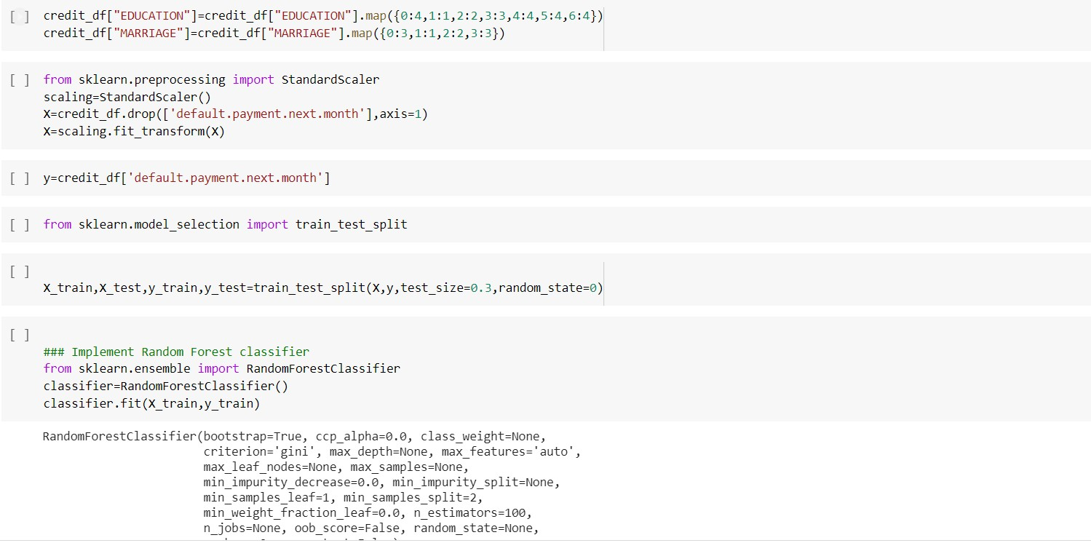

Slide 21
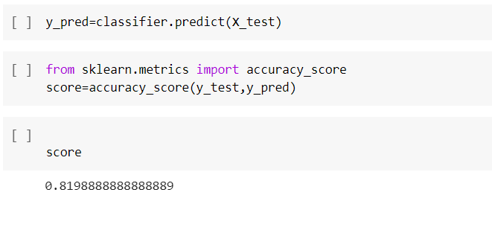

Slide 22
In Review 3 we are going to present a fully deployed model in a website and going to submit a detailed Project Report

Slide 23
Refrences:
https://www.moodysanalytics.com/risk-perspectives-magazine/managing- disruption/spotlight/machine-learning-challenges-lessons-and-opportunities-in-credit-risk- modeling
https://towardsdatascience.com/credit-risk-modeling-with-machine-learning-8c8a2657b4c4 https://www.spglobal.com/marketintelligence/en/news-insights/blog/industries-
most-and-least-impacted-by-covid19-from-a-probability-of-default-perspective

Slide 24


